Slide 1
Sorting Algorithms

Slide 2
Bubble sort

Slide 3
Bubble Sort: visual

Slide 4
Bubble sort: verbal description
Start at the first array element and compare it with the second element. If the first element is larger than the second, swap them. Next, go to the second element and compare it to the third. Thus, you should compare every consecutive pair of elements and swap those that are out of order. Continue traversing the modified array until no more swaps are made. If there are no swaps, it means that you did not find any pairs that were out of order, so you can stop sorting.

Slide 5
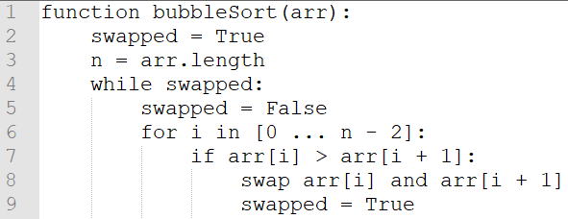
Bubble Sort: Pseudocode

Slide 6
Bubble Sort: evaluation
Complexity: ???
Best case:
Average case:
Worst case:
Pros:
Easy to implement
Easy to understand
Cons:
Very slow

Slide 7
Insertion sort

Slide 8
Insertion Sort: visual

Slide 9
Insertion sort: verbal description
Go over each element in the array (let’s call it x) and compare it to the element before. If x is smaller, then swap it with the first element that is smaller than x, i.e. insert it where it belongs. The assumption here is that the left side is already sorted because we always insert x in the right place.

Slide 10
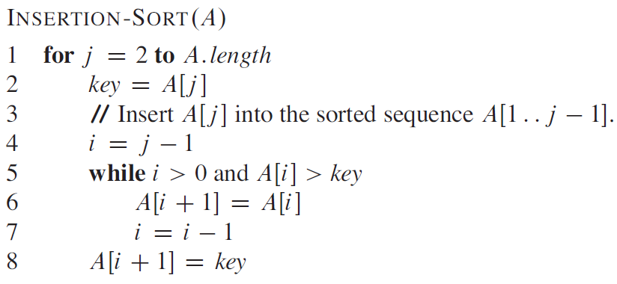
Insertion sort: pseudocode

Slide 11
Insertion sort: evaluation
Complexity: ??? (hint: better than bubble sort)
Best case:
Average case:
Worst case:
Pros:
Same as bubble sort
Cons:
Still slow

Slide 12
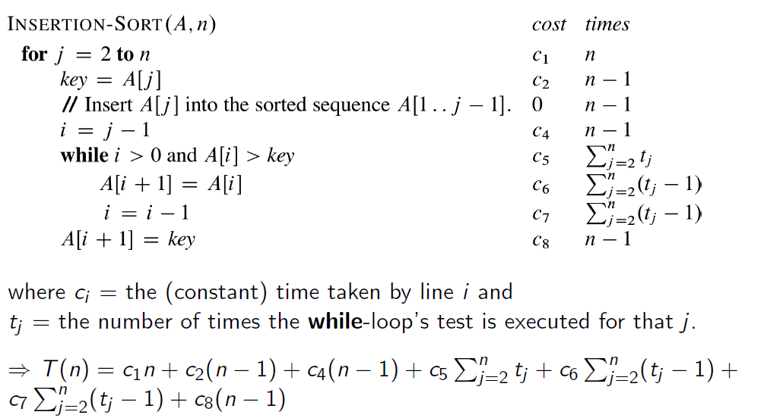
Complexity breakdown

Slide 13
selection sort

Slide 14
selection Sort: visual

Slide 15
selection sort: verbal description
Find the nth smallest element in the array and swap it with the element that is right after the (n-1)the smallest element. In other words, keep finding minimums and placing them in the beginning of the array. This way, you are sort of constructing an array of minimums.

Slide 16
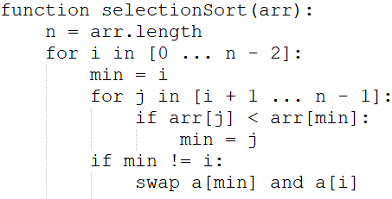
selection sort: pseudocode

Slide 17
selection sort: evaluation
Complexity: ???
Best case:
Average case:
Worst case:
Pros:
Same as bubble sort
Cons:
Still slow

Slide 18
Merge sort

Slide 19
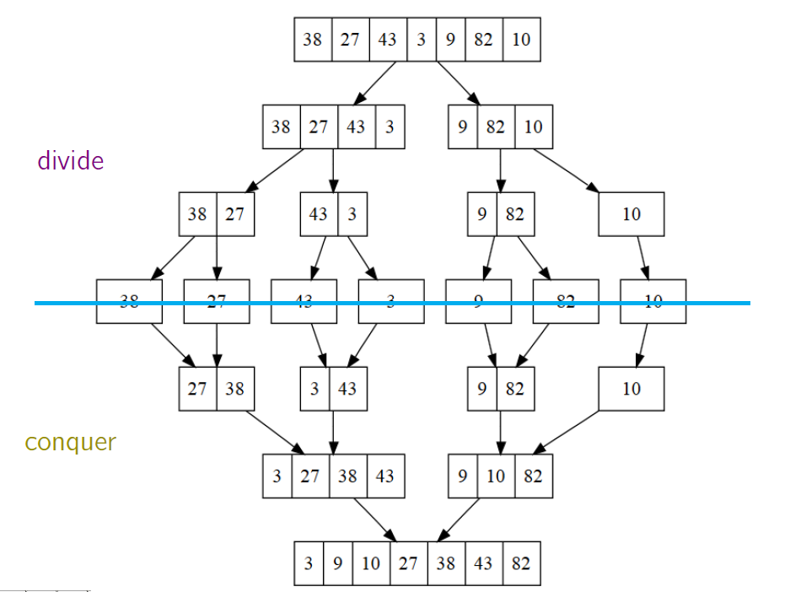
merge Sort: visual

Slide 20
Merge sort: verbal description
Divide the array in halves and merge each by getting the smallest element from each and putting it back into the original array

Slide 21
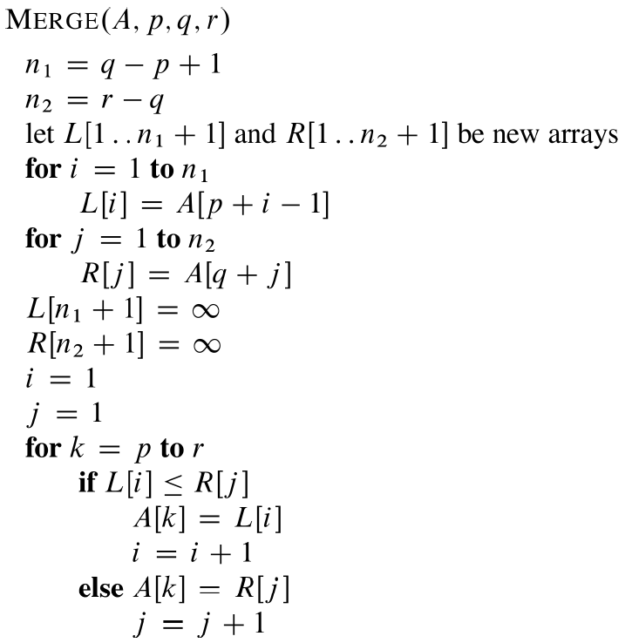
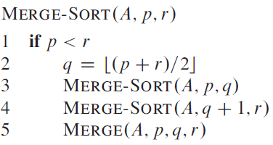
merge sort: pseudocode

Slide 22
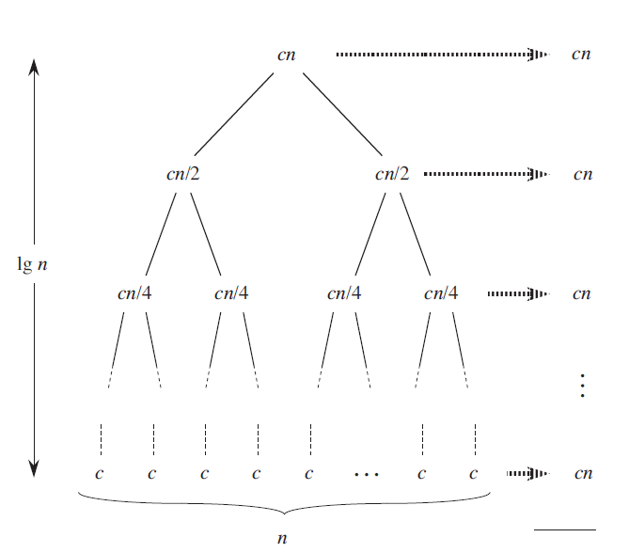

merge sort: evaluation
Complexity: ???
Best case:
Average case:
Worst case:
Pros:
Faster than previous algorithms
Relatively easy to implement
Cons:
Recursion overhead
Extra space complexity because you have to allocate temporary arrays for storing intermediate results

Slide 23
quick sort

Slide 24
quick Sort: visual

Slide 25
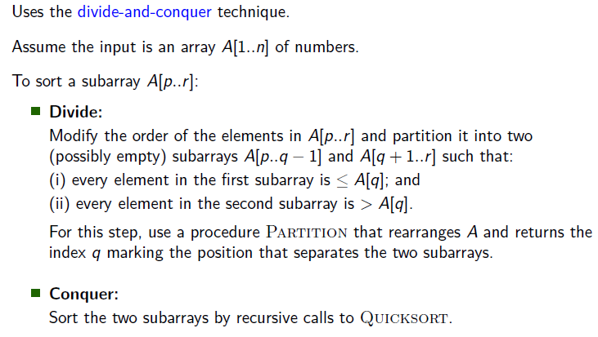
quick sort: verbal description

Slide 26
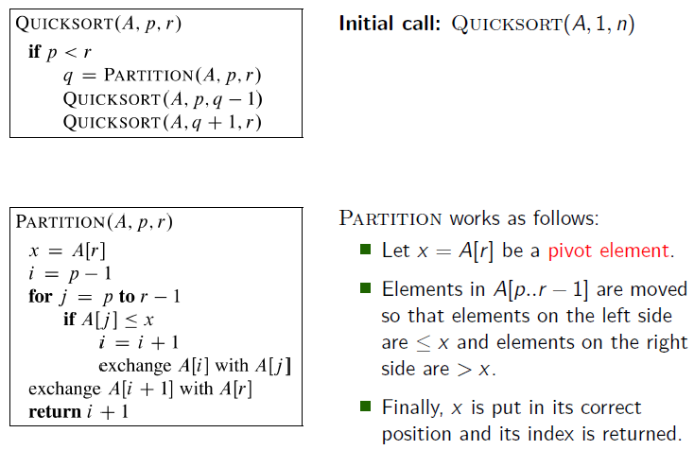
quick sort: pseudocode

Slide 27
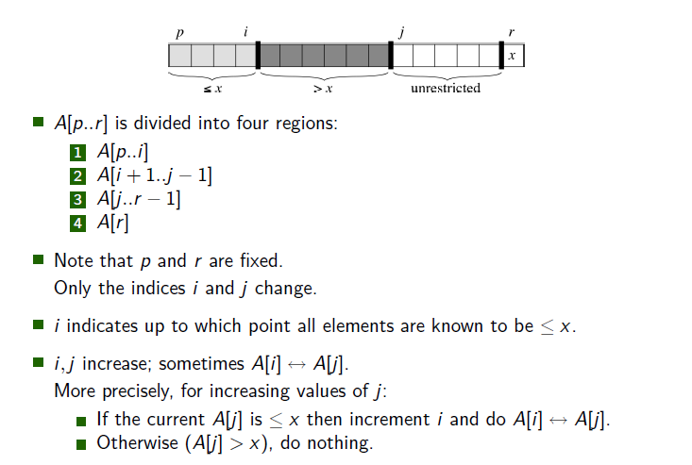
Quick sort: pseudocode

Slide 28
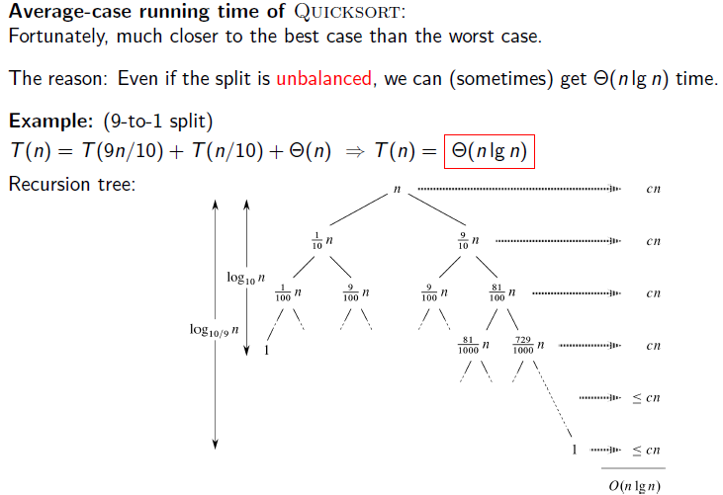
quick sort: evaluation
Complexity: ???
Best case:
Average case:
Worst case:
Pros:
Better best-case complexity
Arguably the fastest sorting algorithm
Relatively easy to implement
Cons:
Recursion overhead

